Slide 1

Elevating Resume-JD Matching
Sibi Seenivasan
Shesadree Priyadarshani
Nitishwar Vasanthakumar

Slide 2



Our Approach
The dataset included repeated instruction style prompts that add noise for classification. We removed this static text so the model trains only on meaningful resume and JD content.
Data Quality is Paramount
Mitigating Data Challenges
Collaborative Infrastructure
Rigorous data cleaning, preprocessing, and feature engineering lay the groundwork for robust and reliable machine learning models.
Proactive strategies to address data leakage and class imbalance are crucial for model integrity and real-world applicability.
Advanced tokenization and platform deployment streamline the development cycle, fostering teamwork and rapid iteration.
Next Steps: Translating Preparation into Performance
Model Training & Evaluation
Continuous Feature Iteration
Deployment & Monitoring
Proceed with diverse model architectures to identify the optimal solution for resume-JD matching.
Explore and integrate additional features to further enhance model accuracy and predictive power.
Implement the chosen model into production, with ongoing monitoring for performance and drift.

Slide 3
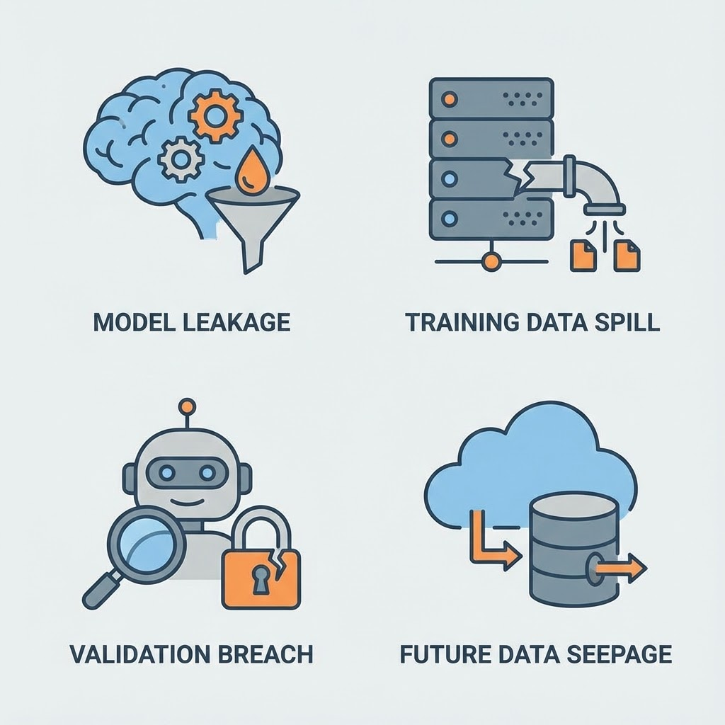
Data Cleaning & Leakage
Removing Instruction Artifacts
The raw text included systematic noise such as "For the given job description <<". (As the dataset seems to be used as prompts for LLM training / fine-tuning)
Action: Implemented Regex cleaning to strip these prefixes and closing brackets (>>) to isolate the actual content.
After feature engineering …
Once the JD and Resume splits were made, the text was once again specifically cleaned, removing content not relevant for our task, like contact information, EEO policy, legal, fluff keywords and more.
b. Data Leakage
Addressing data leakage and class imbalance is crucial for building reliable machine learning models, ensuring their performance translates effectively from development to real-world application.
Data Leakage: The "Before" Scenario
Addressing Data Leakage:
Discovery: The target labels (e.g., "Good Fit") were found embedded inside the input text features in over 6,000 instances.
Risk: This causes "Data Leakage," where the model learns to read the answer rather than understand the resume.
Solution: Developed a string-based removal function to scrub specific label phrases (good fit, no fit, potential fit, fit score) from the input text.

Slide 4
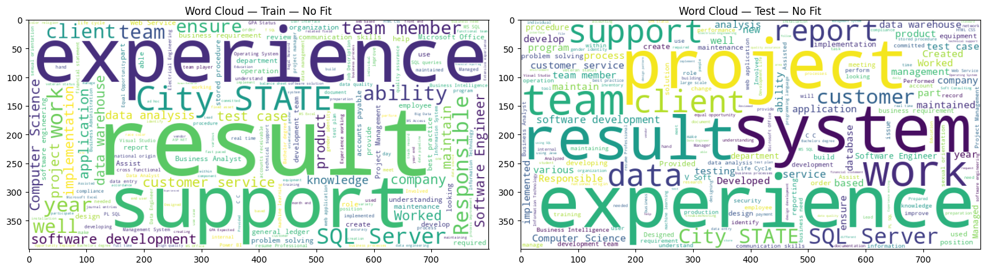
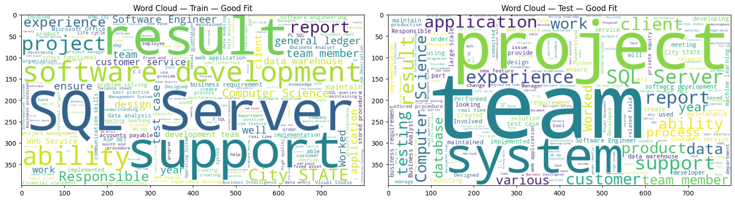
Word Cloud Analysis
The Value of Keywords and Being Specific
`Computer Science` is notably large in the Good Fit word clouds. This suggests a formal educational background or direct tie to the field is a stronger indicator of a Good Fit than a Potential Fit or No Fit.
The terms `application`, `project`, and `test case` are highly visible in the Potential and Good Fit clouds, implying that a focus on deliverables (projects/applications) and quality assurance (test cases) is crucial for a positive outcome.
Both of these suggest that there is a strong correlation with foundational knowledge, customer/stakeholder interaction, and tangible outcomes.
The No Fit cloud contains very generic, business/workplace terms like `support`, `experience`, `team`, and more. While these are necessary, they are not differentiating factors. Their large size suggests that these are the minimum common denominator words, and their over representation without other key technical terms leads to a "No Fit" classification.

Slide 5

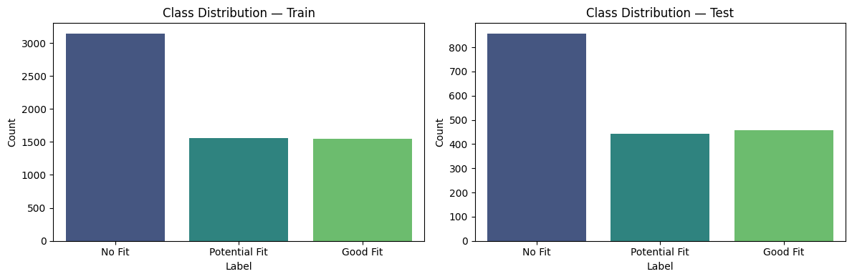
Class Imbalance
Class imbalance, where one class significantly outnumbers another, can bias models towards the majority class. It can also result in giving the model seemingly higher baseline accuracy, while the other metrics can be lower; ie., A model could achieve high accuracy (around 60-70%) simply by guessing "No Fit" frequently.
Analysis revealed a significant imbalance: "No Fit" samples (~3143) are roughly double the count of "Good Fit" (~1542) or "Potential Fit" (~1556) samples.

Slide 6

Advanced Preprocessing: Tokenization & Final Dataset Export
In this stage, we transformed the cleaned text into numerical tensors, making it ready for ingestion by a Transformer model (like DistilBERT), and prepares the final data artifact for training.
01
Tokenization for Deep Learning
We utilized the DistilBERT Tokenizer via the Hugging Face transformers library, which is essential for working with large language models.
Subword Handling: The tokenizer splits words into subword units, allowing the model to handle typos, rare vocabulary, and out-of-vocabulary words effectively.
Uniform Input: Input text was systematically cut off if it exceeded the maximum sequence length of 512 tokens.
02
Reproducible Dataset Export
Saving to Hub: The completely processed and tokenized dataset was pushed to the Hugging Face Hub under the repository “persona-156/tokenized-resume-fit-data”.
Benefits: This workflow ensures reproducibility by making the exact training data readily accessible to any team member or training environment with a single line of code, bypassing the need to run the entire cleaning pipeline repeatedly.

Slide 7
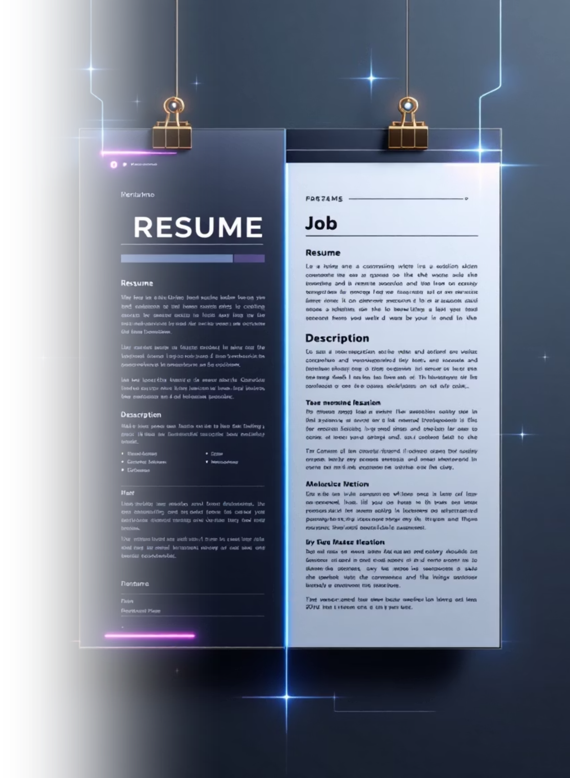
Model Development
Development and evaluation of machine learning models on resume-job description fit analysis. We'll cover data feature engineering, model training, and performance evaluation.

Slide 8
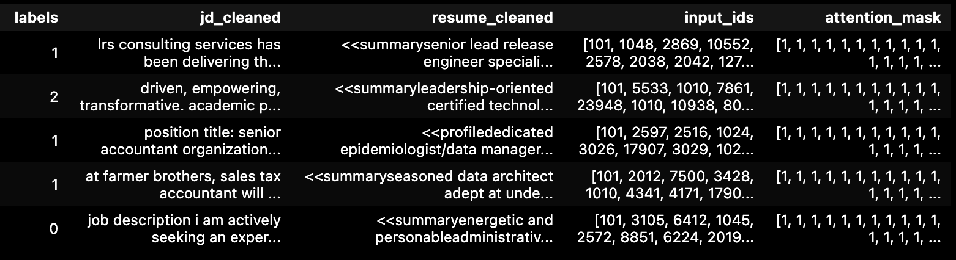
Initial Data Loading & Overview
We begin by loading the cleaned resume dataset uploaded on the hugging face, which is pre-processed for model training. The dataset is split into training, validation, and testing sets.
A sample view of the resume dataset post-cleaning and preprocessing.
Columns 1, 2, and 3 are used for the base model, while columns 4 and 5 are incorporated in the advanced model.
Dataset shape for Train, validation and Test
Train df
Validation df
Test df
Shape: (5616, 3)
Shape: (625, 3)
Shape: (1759, 3)

Slide 9
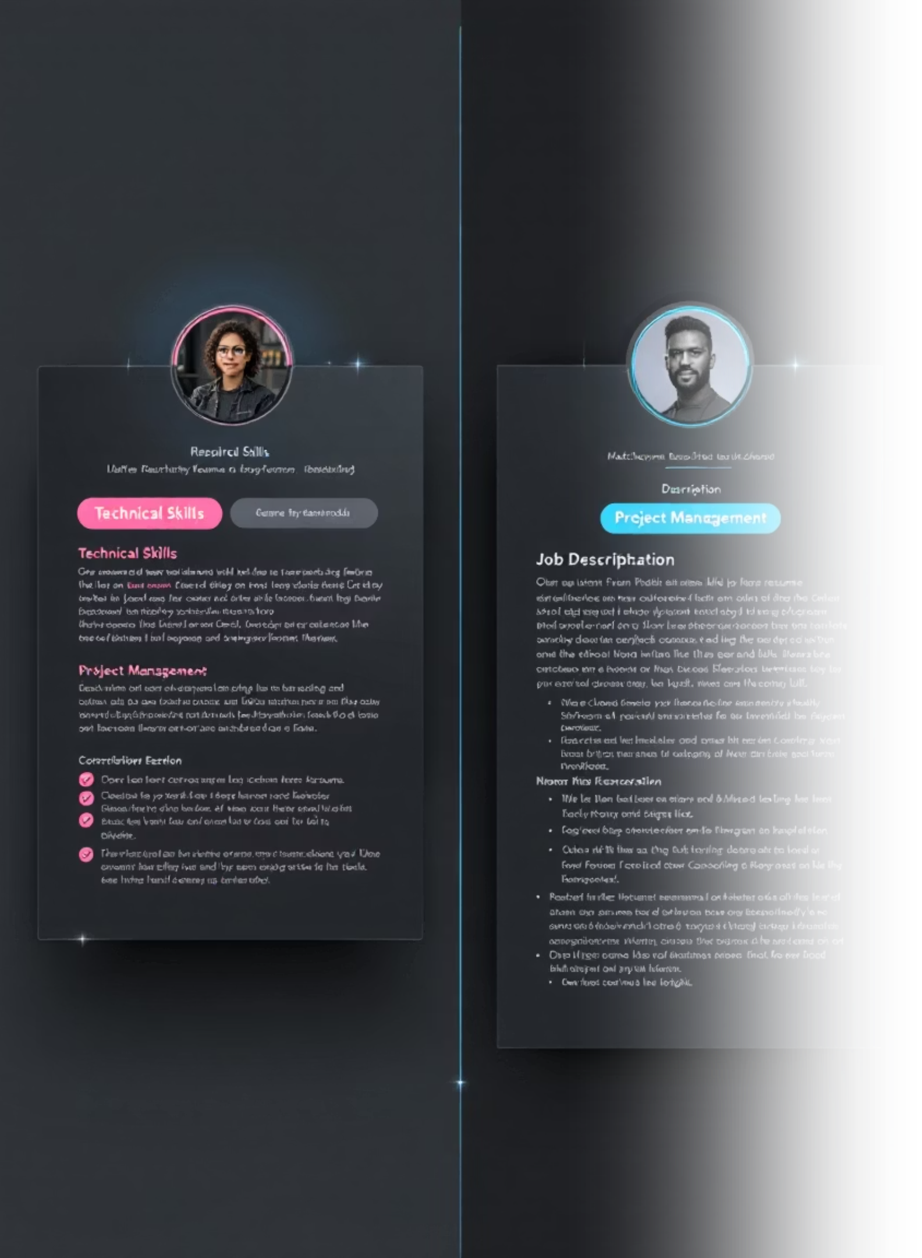
Feature Engineering: Skill Matching
To quantify the relevance between resumes and job descriptions, we extract and match skills. This involves identifying keywords and calculating match counts and ratios.
1
Keyword Extraction
TF-IDF vectorization identifies key skills from job descriptions, creating a vocabulary of 12000 features.
2
Skill List Generation
Each job description is processed to create a list of relevant skills present in our vocabulary.
3
Match Count
Calculates the number of matched skills between a resume and a job description.
4
Match Ratio
Determines the proportion of job description skills found in the resume.

Slide 10


Text Vectorization with TF-IDF
We convert cleaned text data into numerical vectors using TF-IDF, capturing the importance of words in job descriptions and resumes.
Job Description TF-IDF
Resume TF-IDF
Max features: 12000, ngram_range=(1,2), stop_words="english". Applied to training, validation, and test sets.
Max features: 12000, ngram_range=(1,2), stop_words="english". Applied to training, validation, and test sets.

Slide 11
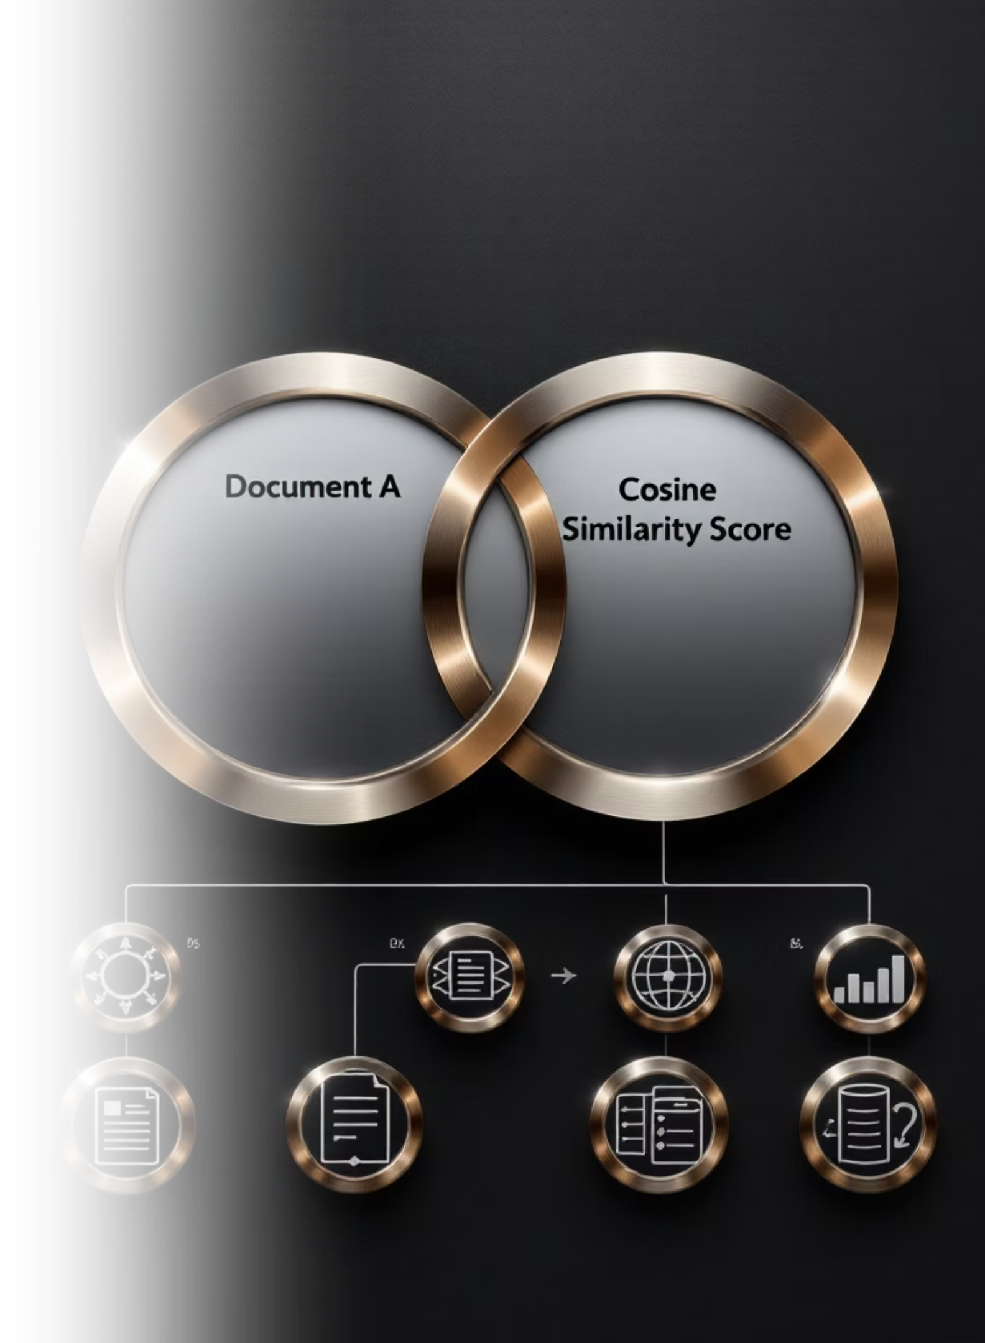


Cosine Similarity & Feature Scaling
Cosine similarity measures the textual similarity between job descriptions and resumes. Numerical features are then scaled for model compatibility.
Cosine Similarity
Calculates the similarity between JD and resume TF-IDF vectors, providing a crucial feature for model training.
Feature Scaling
Numerical features like skill match count and ratio are scaled using StandardScaler to ensure consistent input for models.

Slide 12
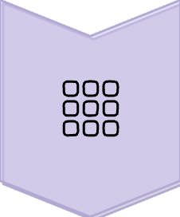




Assembling the Feature Matrix
All engineered features—TF-IDF vectors, cosine similarity, and scaled numerical features—are horizontally stacked to form the final input matrix for our models.
Combined Feature Matrix
JD TF-IDF
Resume TF-IDF
Cosine Similarity
Scaled Numerics
The training feature matrix (X_train) has a shape of (5616, 24003), indicating a rich set of features for model learning.

Slide 13



Initial Model Training
We trained three different classification models: Logistic Regression, Support Vector Machine (SVM), and XGBoost to establish baseline performance.
Logistic Regression
SVM (SGDClassifier)
XGBoost Classifier
Solver: saga, Penalty: l2, Max Iter: 10000
Loss: hinge, Penalty: l2, Max Iter: 8000
Objective: multi:softmax, Num Class: 3, N_estimators: 250

Slide 14
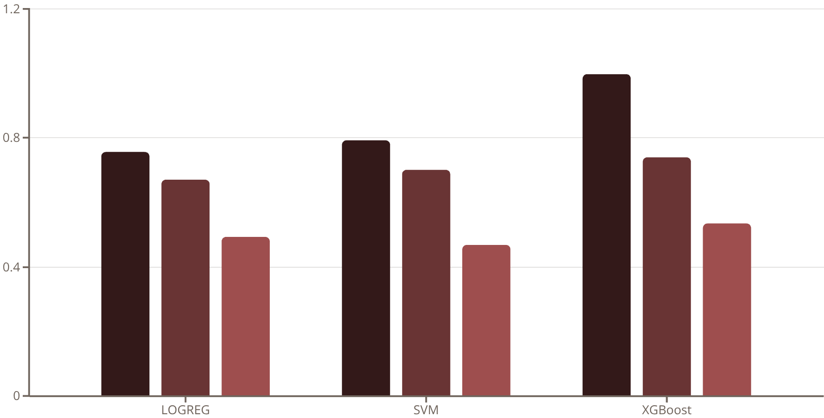
Baseline Model Performance
Initial evaluation shows varying performance across models, with XGBoost achieving the highest accuracy on the training set but showing potential for overfitting.
Train Accuracy
Validation Accuracy
Test Accuracy
To Note: Test set contains real-world, noisy samples, making it significantly harder and causing a noticeable performance drop.
For model to improve, we re-split the data with stratification removed the distribution mismatch, allowing the model to learn more effectively across all sets.

Slide 15
Hyperparameter Tuning for XGBoost
To optimize performance and combat overfitting, we implemented an automated hyperparameter tuning strategy using RandomizedSearchCV with a GPU-optimized XGBoost pipeline. Before tuning, we rebuilt a clean train-validation-test split to ensure evaluation fairness. The final dataset distribution was:
5600
1200
1200
24,003
Training Samples
Validation Samples
Test Samples
Feature Dimensions
Training set samples
Validation set samples
Test set samples
TF-IDF features
This split allowed us to monitor model behavior during training and avoid data leakage.

Slide 16
Automated Tuning Strategy & Optimal Configuration
Our tuning strategy explored a robust parameter space for complexity regularization and learning stability, including tree depth and subsampling ratios. We executed 10 parameter configurations across 2-fold cross-validation, which ensured both speed and reliability. Since the process used GPU acceleration, optimization was significantly faster than CPU-based approaches.
The best performing configuration parameters were:
subsample = 0.8
n_estimators = 400
max_depth = 6
learning_rate = 0.06
colsample_bytree = 0.7
reg_lambda = 2.5
reg_alpha = 0.4
min_child_weight = 3
This combination achieved a balance between model flexibility and regularization reducing overfitting while still learning complex patterns. The moderate depth and controlled subsampling ratios helped stabilize training and improve generalization.

Slide 17
Model Performance & Evaluation
After hyperparameter selection, the final model was evaluated across training, validation, and test sets.
Performance Metric
Accuracy
Weighted F1
ROC-AUC
Training Performance
0.9900
0.9900
0.9997
Validation Results
0.7592
0.7592
0.8858
Test Set Performance
0.7433
0.7430
0.8754
Good performance across all metrics, with strong recall, and F1 scores above 0.74. The model generalizes reasonably well, with an expected reduction from training performance. Consistent performance with validation, indicating good generalization
ROC Curve Analysis
The ROC curves provide detailed insights into model performance across all three datasets. These curves demonstrate excellent discrimination ability on training data and good generalization performance on the validation and test sets.

Slide 18
Model Diagnostics & Final Export
Prediction behavior was thoroughly inspected using confusion matrices, classification reports, and multi-class ROC curves (One-vs-Rest), confirming strong precision, recall, and balanced performance across all classes.
Feature Importance Analysis
We computed feature importance to understand which features contributed significantly to model decisions. The top-ranking features showed clear patterns in resume-job description matching.
33.91%
28.51%
Feature f8340
Feature f7233
Exact job title matching
Significant contribution to decisions
24.70%
13.01%
Feature f20075
Feature f8419
Strong driver in keyword ranking
Important for pattern recognition
These features were highly interpretable, linking keywords, skills, and experience-related terms that drive the matching decisions.

Slide 19
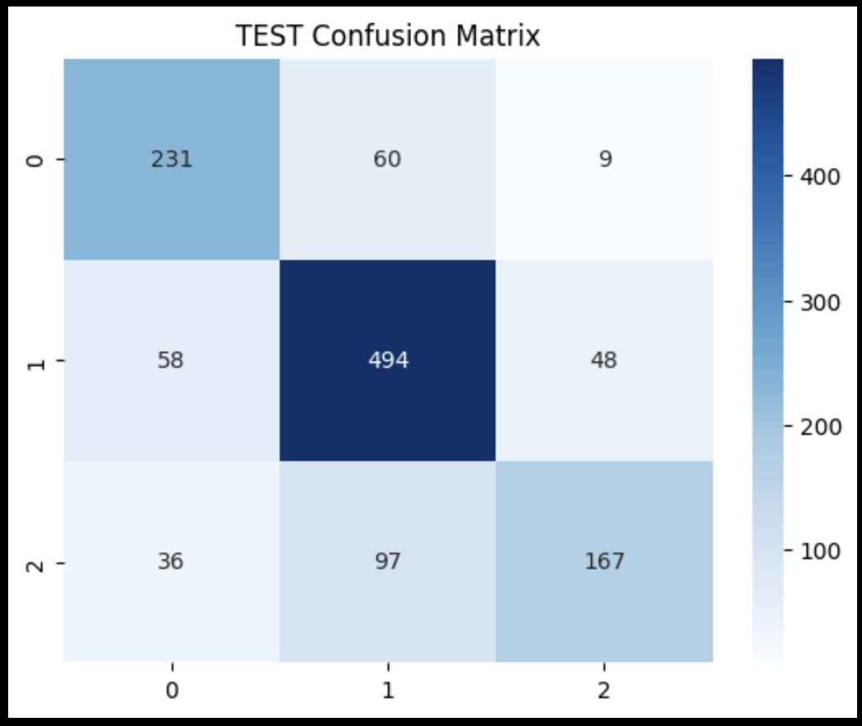
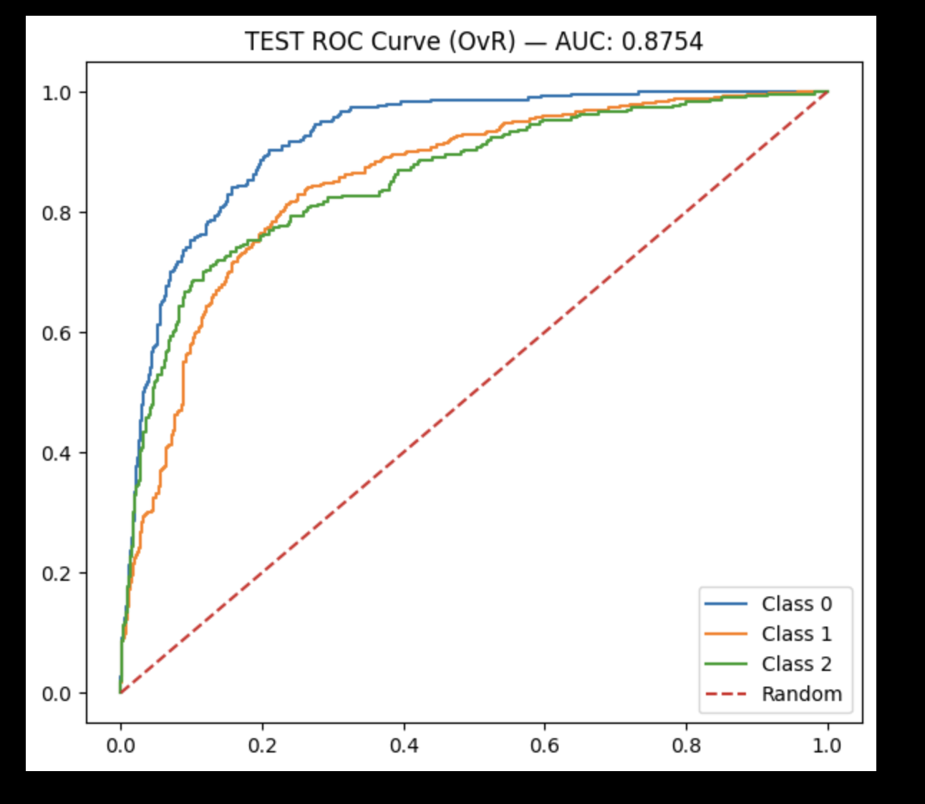
Test Set ROC Analysis
The final test set ROC analysis demonstrated strong discrimination ability on completely unseen data, validating our hyperparameter tuning approach.

Slide 20

Fine-Tuning BERT for Job-Resume Matching
Fine-tuning a BERT-based model for classifying job-resume compatibility, leveraging Hugging Face Transformers and PyTorch.

Slide 21

Setup and Data Preparation
Tokenized Dataset
Model Initialization
From the uploaded tokenized resume data, we use the input_ids and attention_mask (lists of integers) for our advanced model.
Loaded a pre-trained DistilBertForSequenceClassification model with 3 labels (0,1,2) and moved it to the GPU.
Environment Check
from transformers import DistilBertForSequenceClassificationmodel = DistilBertForSequenceClassification.from_pretrained("distilbert-base-uncased", num_labels=3)model.to("cuda")
Verified CUDA availability and identified the NVIDIA L4 GPU for accelerated training.
import torchprint(torch.cuda.is_available())print(torch.cuda.get_device_name(0))
Output: True, NVIDIA L4
Output: cuda:0

Slide 22





Training Configuration and Results
Training Arguments
Configured training with 8 epochs, batch size 4, learning rate 2e-5, and FP16 for speed.
Weighted Loss
Implemented a custom WeightedTrainer to use class weights for imbalanced datasets.
Performance
Achieved 62.72% accuracy, 62.12% F1-score, and 82.33% AUC on the validation set.
Test Evaluation
Test set results: 49.74% accuracy, 44.64% F1-score, and 64.19% AUC.

Slide 23


DistilBERT Training and Evaluation After Data Splitting
Stratified train-test split of the full dataset to ensure balanced label distribution.
Training Configuration
Weighted Loss Function
Training Arguments define hyperparameters: 8 epochs, batch size 8, learning rate 2e-5, and FP16 for efficiency.
A custom Weighted Trainer uses nn.CrossEntropyLoss with class weights to handle imbalanced datasets.
74.25%
89%
Validation Accuracy
Validation AUC
Achieved on the validation set after 8 epochs.
Area Under the Curve, indicating model's discriminative power.
73.5%
88%
Test Accuracy
Test AUC
Performance on unseen test data.
AUC score on the test set.

Slide 24






Cross-Attention Model Architecture
A custom BERT-based model with cross-attention for enhanced contextual understanding between job descriptions and resumes.
Cross-Attention Layer
JD tokens attend to Resume tokens, capturing inter-document relationships.
Dual BERT Encoders
Separate BERT encoders for Job Description (JD) and Resume.
Classification Head
A sequential linear layer for final label prediction.
This model achieved a test accuracy of 73.67% and an AUC of 87.7%, demonstrating robust performance.

Slide 25



CONCLUSION
We analyzed classical machine learning and advanced deep learning for resume-job description matching, evaluating their strengths in understanding semantic relationships.
Classical ML Models
Advanced AI Models
Using TF-IDF, skill counts, and cosine similarity, we trained Logistic Regression, SVM, and XGBoost.
We used tokenized input for DistilBERT and a custom Cross-Attention Dual-Encoder Model.
Best Performer: XGBoost (Test AUC: 0.8754) after tuning.
DistilBERT: Val: 89% AUC; Test: 88% AUC.
Pros: Interpretability, fast training, reliable generalization.
Cross-Attention Dual-Encoder: Test: 87.7% AUC.
Pros: Captures nuanced context, handles complex semantics, robust on noisy data.
Cons: Limited for noisy, real-world text without deeper context.
Cons: High computational demands, requires meticulous tuning.
Key Insight: While classical models are good, advanced transformer-based models consistently perform better by understanding richer semantic relationships. This is crucial for noisy, real-world data.

Slide 26
Baseline Model Performance (Slides kept for reference)
Initial evaluation shows varying performance across models, with XGBoost achieving the highest accuracy on the training set but showing potential for overfitting.
LOGREG
SVM
XGB
TRAIN ACC
0.7568
0.7926
0.9991
TRAIN F1
0.7529
0.7920
0.9991
VAL ACC
0.6720
0.7008
0.7408
VAL F1
0.6644
0.7004
0.7367
TEST ACC
0.4946
0.4690
0.5344
TEST F1
0.4610
0.4614
0.5147

